Slide 1

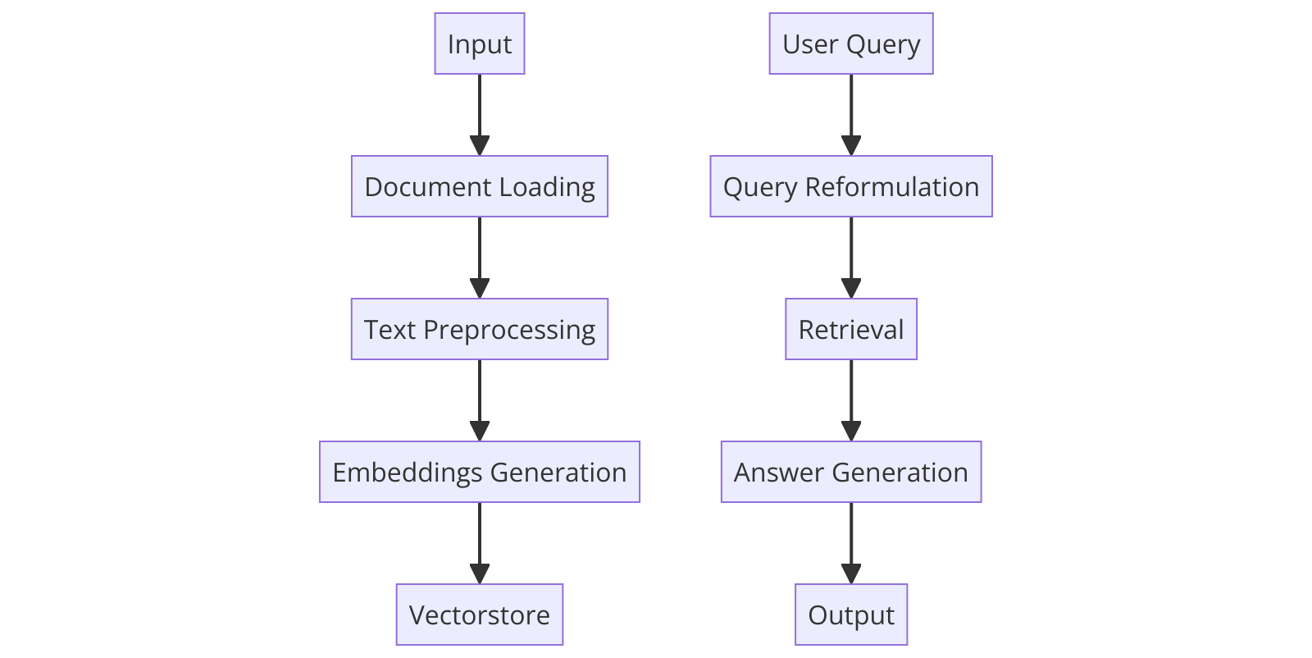
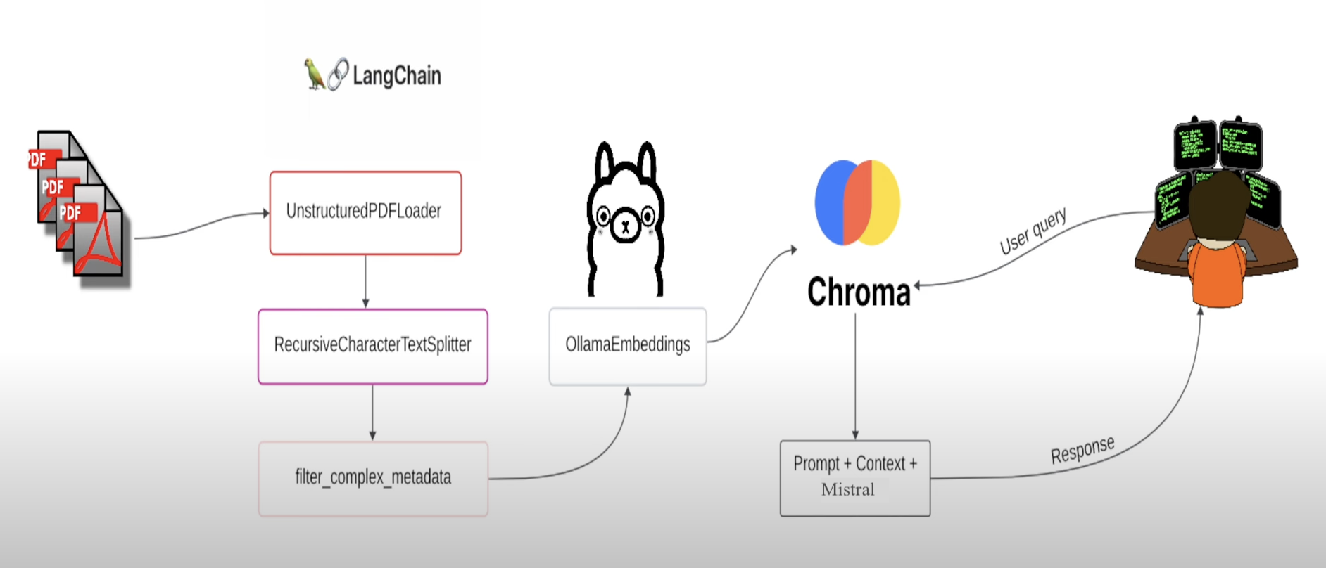
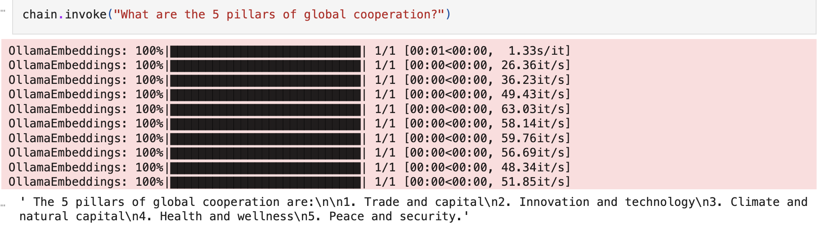
Retrieval-Augmented Generation: Answering Questions from PDF Documents Junaid Yeasir Fahim, advised by Dr. James Skon & Professor Jon Chun COMP401 Seminar, Kenyon College
Introduction
System Overview & Results
The main goal for this project is to develop a Retrieval-Augmented Generation (RAG) system that efficiently answers questions from vast amounts of information in PDF documents.
The objectives in doing so:
Integrate information retrieval and language generation methods
Enable precise and relevant answers to user queries
Extract knowledge from unstructured data and make it easily accessible
Input: The starting point – this is where the user uploads their pdf and later interacts with the RAG system by typing in their question.
Document Loading: The system processes the source document (in this case, a PDF) and extracts the text.
Text Preprocessing: The raw text is cleaned and prepared for the LLM (tokenization, normalization, etc.).
Embedding Generation: Text is transformed into dense vector representations that capture meaning.
Vectorstore: Stores the text embeddings, enabling efficient relevance & similarity-based searches.
But why?
User Query : The user's interaction point with the RAG system.
Query Reformulation (LLM): The LLM generates multiple versions of the question to improve retrieval
results.
Retrieval: The reformulated queries are used to find the
Extractive Question Answering (EQA):
Answers are directly extracted from a given text source.
Contrasts with generative question answering where the model creates its own response.
LLMs in Text Analysis and Question Answering:
Increasingly powerful tools for analyzing text and finding answers to complex questions.
Potential to revolutionize how we interact with and extract information from documents.
Figure 1: Process flow Diagram of the RAG system
most relevant text chunks from the Vectorstore.
Answer Generation (LLM): The LLM processes the retrieved text along with the original question to formulate a final answer.
Output: The answer is presented to the user in a clear format.
Real-World Applications
Information Retrieval Systems: Streamline how users find answers within large document libraries or research databases. E.g. Hospitals, Case Files, Govt. Institutes etc.
Educational Tools & Intelligent Tutoring Systems: Create interactive systems where students can ask questions about studied materials and receive tailored explanations.
Customer Service Chatbots: Improve the responsiveness and accuracy of automated customer support systems, allowing them to provide answers directly derived from product documentation or FAQ resources.
Figure 2: High Level System Architecture diagram of the RAG system
Figure 3: Input & Output demonstration of the RAG system. Here after uploading ”WEF_The_Global_Cooperation_Barometer_2024.pdf”, I asked the following question to the system (User Query) to which the system answered the following.
Future Directions
Reference / Acknowledgements
Expanding Input Sources: Explore how to adapt the system to handle different document types like codes, web pages, and other data types.
Enhancing Answer Quality: Research how to add summarization capabilities to condense long answers for easier digestion.
LLM Experimentation: Evaluate the performance impact of using different and potentially newer LLM architectures for specific tasks within the system.
Yan, S.-Q., Gu, J.-C., Zhu, Y., & Ling, Z.-H. (2024). Corrective Retrieval Augmented Generation. arXiv:2401.15884 [cs.CL]. https://arxiv.org/abs/2401.15884
https://api.python.langchain.com/en/latest/langchain_api_reference.html

